Slide 1
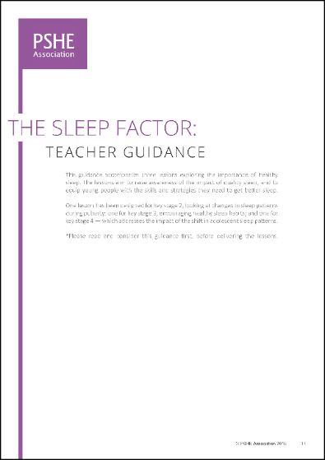
Ensure you read the guidance before teaching the lesson
Teacher
slide
The Sleep Factor
KS2
Taking care of myself :
getting a good night’s sleep

Slide 2
Teacher
slide
Using this PowerPoint
The slides in this presentation are divided into two sections:
Teacher slides (purple) – provide key information regarding lesson preparation
Pupil slides (white) – provide a visual focus point for pupils during the lesson and delivery notes for teachers about the activities. Click ‘notes’ to view these.
Ensure that you select ‘Use Presenter View’ under the ‘Slide Show’ tab – this will allow you to preview the teaching notes on your monitor while the main presentation is displayed on a screen/smartboard.
© PSHE Association 2018

Slide 3
Teacher
slide
Challenge and support
The lesson includes suggestions for challenge and support activities, to help you differentiate appropriately for your class.
Challenge activities deepen and extend the learning for those who need more challenge or who finish the activity quickly.
Support activities are adapted to be more accessible for those who need it.
Look for the logo on the pupil slides. See delivery notes for details of the activities.
Support
Challenge
© PSHE Association 2018

Slide 4
Teacher
slide
Context
This lesson explores why sleep is so important in children’s lives and how sleep patterns change during puberty. It considers what the foundations of good quality sleep are, promotes taking responsibility for bedtime routines, and reflects on how these habits can be effectively embedded.
As children grow older and enter puberty, they will benefit from well established, consistent sleep patterns.
This lesson is best used within a unit of work on healthy, balanced lifestyles; preparing for transition to secondary school; or during sessions about the changes that occur to the body during puberty.
There are accompanying lessons for key stages 3 and 4, which explore how to maintain good quality sleep during adolescence.

Slide 5
Teacher
slide
Developing subject knowledge
6-12 year olds:
require 10-11 hours of sleep per night, but many only average 9-10 hours –although the amount of sleep required will vary between individuals
may experience sleep problems such as: difficulty falling and staying asleep, sleepwalking, sleep terrors, teeth grinding, nightmares or snoring
need a regular sleep schedule - waking up and going to sleep at the same time every day (including at weekends)
should go to bed before 9pm
should have bedtime routines including calming activities (e.g. reading)
should avoid screen use or overly energetic activities an hour before bed
should avoid caffeinated or high sugar products, such as tea, sweets and fizzy drinks, particularly during the afternoon and evening.

Slide 6
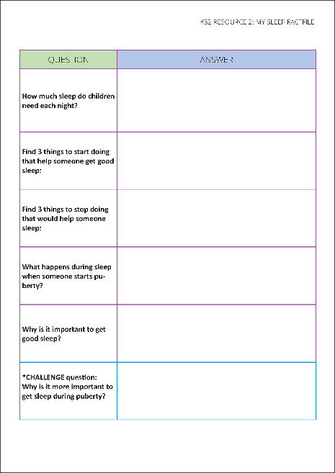
Teacher
slide
Working with parents
The engagement of parents in this topic would be advantageous. Parents could be informed via the school newsletter, website or blog — this would enable them to be supportive of this aspect of their child’s learning. Resource 2: My sleep fact file could also be shared with parents as part of a homework activity.
© PSHE Association 2018

Slide 7
Teacher
slide
Learning objective
To learn about the importance of good sleep
Learning outcomes
Pupils will be able to:
explain why sleep is important for a healthy lifestyle
describe bedtime routines that help improve sleep
identify how sleep patterns and needs might change during puberty
© PSHE Association 2018

Slide 8
Teacher
slide
Preparing to teach
Climate for learning
Make sure you have read the accompanying teacher guidance notes before teaching this lesson – for guidance on establishing ground rules, the limits of
confidentiality, communication and handling questions effectively.
Resources required
Box/envelope for anonymous questions
Resource 1: facts about sleep
Resource 2: My sleep fact file
Resource 3: Sleep buster solutions
Duration
This has been designed to be taught as a sixty minute PSHE education lesson
Further guidance
Members of the PSHE Association can access our website for further guidance www.pshe-association.org.uk
60
© PSHE Association 2018

Slide 9
Teacher
slide
Lesson summary
Activity | Description | Timing
Introduction | Introduce or revisit ground rules | -
2. Baseline assessment | Pupils draw a person getting good sleep, and add ideas about what might be helping or hindering them | 10 MINS
3. Fact hunt | Pupils discover facts about sleeping using posters displayed around the room | 20 MINS
4. Sleep schedule | Make a spider diagram of special people on the flipchart (using the central character in the story as an example). Pupils repeat activity referring to their own special people | 15 MINS
5. Endpoint assessment | Pupils respond to questions about the friendship described in the story. | 10 MINS
© PSHE Association 2018

Slide 10
Z
Z
Z
Z
Taking care of myself:
getting a good night’s sleep

Slide 11
Ground rules
[Add your class rules here]
Notes:
Teacher Notes
Use this slide to display your class agreement / ground rules for PSHE education lessons. See Accompanying Teacher Guidance Notes (separate document).

Slide 12
Sleep: What’s our starting point?
Draw a person getting ready for a good night’s sleep — what might they be doing, thinking, feeling?
Can you draw and write about:
How this person will feel when they wake up?
Anything that is helping them to sleep well?
Anything that might make it hard for them to sleep well?
Notes:
Teacher Notes - Baseline assessment (10 mins)
It is important that pupils complete this activity individually. Do not guide or prompt their answers. When finished, collect in their papers. Explain you will revisit this work at the end of the lesson. Look through pupils’ ideas to elicit an understanding of what pupils already know about the importance of sleep and routines that promote good sleep.

Slide 13
We are learning about the importance of good sleep
We will be able to:
explain why sleep is important for a healthy lifestyle
describe bedtime routines that help improve sleep
identify how our sleep patterns and needs might change as we grow up
Notes:
Teacher Notes – Learning objective and outcomes
Introduce the learning objectives and outcomes, explaining that this lesson will explore why it is important to get good sleep, and how sleep patterns change during puberty.

Slide 14
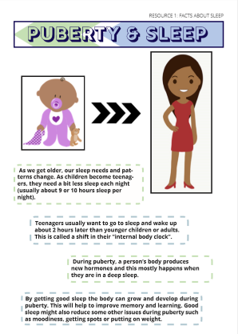
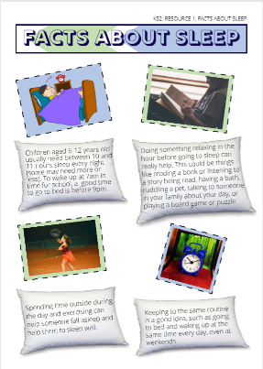
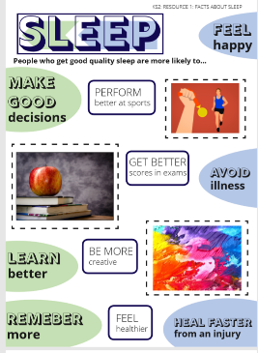
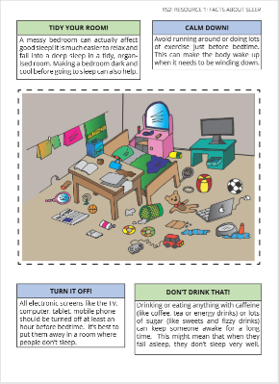
Why is sleep important?
?
?
?
Go on a fact hunt…
Look at the posters displayed around the classroom.
Use them to help answer the questions on the worksheet.
?
?
?
Notes:
Teacher Notes – Fact hunt (20 mins)
Pin up posters: Resource 1: Facts about sleep around the classroom (depending on the size of the class, you may need more than one copy of each poster). Pupils work in pairs, to complete Resource 2: My sleep fact file - moving around the room looking at the posters and hunting the ‘facts’ needed to answer the questions. Pupils trade and share facts with other pairs as they discover more. Pupils could be encouraged to take home their completed sleep fact file to share with parents or family members.
Challenge: A challenge question is provided on Resource 2: My sleep fact file. Pupils can then identify 3 facts they think are most important for children their age and explain why they think this.
Support: Pupils could be paired with a more confident reader / scribe or teaching assistant if available. Alternatively, create a bag of objects/pictures related to sleep (or that might be found in a child’s bedroom) and ask them to sort into piles — things that help or things that hinder sleep (it is also helpful to include a “not sure/it depends” pile). Items might include: teddy bear, night light, mobile phone, pet, story book, eye mask, alarm clock, a fizzy drink can etc..

Slide 15
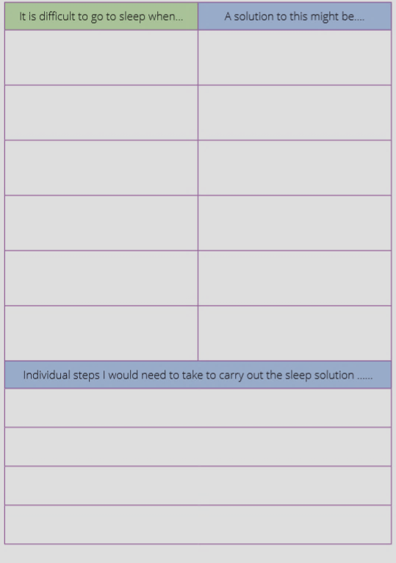
Sleepbusters
Discuss…
What types of activities do children and young people do after school?
Do these help or hinder sleep?
Work in pairs to complete the sleep buster solutions grid
Notes:
Teacher Notes – Sleep schedule (15 mins)
Work as a whole class to discuss different activities — for example attending after-school clubs, sports teams, hobbies, favourite TV programmes, playing with brothers/ sisters, eating dinner, chores, homework and bedtime routines (brushing teeth, washing, reading and calming down).
Pupils work in pairs to complete Resource 3: Sleep buster solutions.
For feedback, pupils could share their ideas regarding the challenges and solutions for getting to sleep with other pairs and compare similarities and differences. Invite the class to vote on the most helpful solutions. Pupils who undertook the challenge activity could present their ideas to the rest of the class — asking them to guess which solution their steps are designed to achieve. Some of the activities could then be shared with parents via the school website/newsletter and in school assemblies.
Challenge: Pupils imagine someone their own age who needs some advice on the necessary steps to carry out their ‘sleep solution’. Pupils complete the bottom section of Resource 3: Sleep busters solutions giving detailed practical instructions about how to implement their solution to ensure they get enough sleep.
Support: Pupils design a 6 box storyboard by drawing pictures to show what a person of their age might do in the evening to get ready for bed.

Slide 16
Sleep: Where are we now?
Go back to the ‘What’s our starting point?’ activity
Is there anything you would like to change?
Is there anything you would like to add?
Use a different colour pen or pencil to amend your draw and write and show how your thinking has developed or changed.
Notes:
Teacher Notes – End-point assessment (10 mins)
Return pupils’ draw and write sheets from the start of the lesson. Ask them to now use a different colour pen / pencil to make any additions or changes they can to their original drawing, as a result of their learning in today’s lesson.
If time allows, you could ask pupils to quietly reflect on one thing they would consider changing about their bedtime routine to help them get better sleep.

Slide 17
Remember…
Finding it hard to get to sleep or not wanting to get up in the morning are all typical experiences as part of growing up. Many adults can sometimes find it hard too. It can sometimes happen when people feel worried or feel stressed about something.
The ChildLine website also has advice about sleep for young people:
www.childline.org.uk
If you’re worried about your sleep, you should always speak to your parent or a trusted adult in school so they can help you.
Notes:
Teacher Notes – Signposting support
Important - reassure pupils that finding it hard to get to sleep/not wanting to get up in the morning are all normal experiences as part of growing up and many adults can also sometimes find it hard to get to sleep/wake up in the morning. Remind pupils who they can talk to if they are worried. In the first instance this should be their parents or a trusted adult in school.
Websites such as Childline provide helpful advice such as ‘8 tips for better sleep’ which you may also want to share with the class https://bit.ly/2FAk5eo

Slide 18
More activities
Sleep story
Write a short story about a character who is struggling to get a good night’s sleep. Include advice for others about how they solved the problem.
Give me 10
Make a list of 10 top tips for a good night’s sleep.
Can you create a 5-minute presentation to share in a whole school assembly?
10 TOP TIPS
Notes:
Teacher Notes – Extension activities
These activities can be included if you have additional time in the lesson or afterwards, to challenge pupils who need to be stretched or for pupils who demonstrate a particular interest in this topic.

