Slide 1


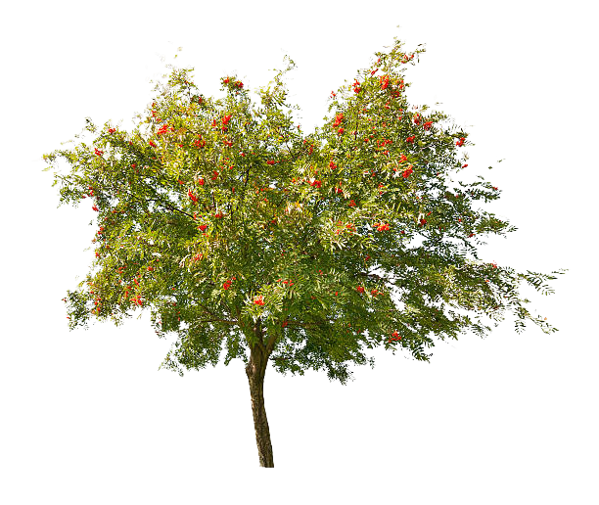
Welcome to year 5
Miss Patten – Maple class teacher
Mrs Heenan – Rowan class teacher
Mrs Hire – Teaching Assistant
Miss Patten – 1:1 teaching assistant (Rowan)
Mrs Tunmore – 1:1 teaching assistant (Maple)
Curious | Inspired | Resilient

Slide 2
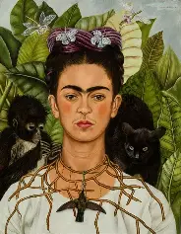
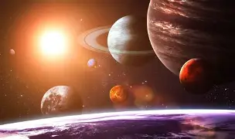
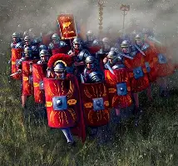
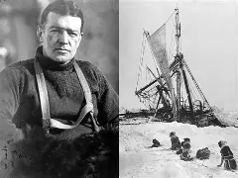
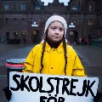
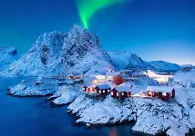
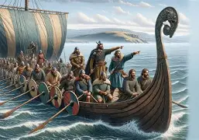
Curious | Inspired | Resilient
Our Topics over the year
Term 1- Mexico (Frida Kahlo)
Term 2 – Romans
Term 3 – Space
Term 4 – Antarctica (Ernest Shackleton)
Term 5 – Scandinavia (Greta Thunberg
Term 6 – Vikings
Notes:
Prompt:
- How will you activate the prior knowledge that children require in this lesson?

Slide 3
PE
Curious | Inspired | Resilient
Year 5 PE will be on a Wednesday afternoon.
This will be the same day across the whole year.
Swimming boosters for some children (separate letters have been sent out).
PE kit – white or maroon t-shirt
black / navy shorts
suitable trainers
black, grey or navy joggers / jumper (when bad weather
long hair tied up

Slide 4
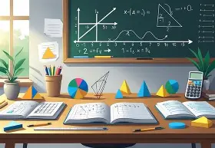
Homework
Curious | Inspired | Resilient
1 piece of maths
1 piece of English
Minimum 3 reads + reading challenge
Sent home on a Friday and due in by Thursdays.
Children will be rewarded with a dojo for each completed piece of homework!

Slide 5
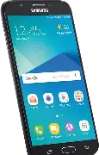
Mobile Phones
Curious | Inspired | Resilient
Complete a phone agreement form
Child MUST hand their mobile to class teacher which will be stored safely in the classroom cupboard.
Not to be use on school premises.

Slide 6
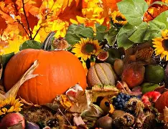
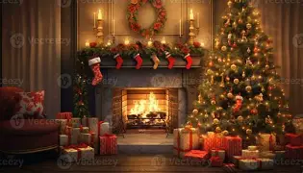
Key Dates
Curious | Inspired | Resilient
Swimming boosters – September 15th, 22nd and 29th
October 6th, 13th and 20th
Harvest festival and crafts – Thursday 8th October
School trip – Tuesday 3rd November and TBC
Christmas carol service – Thursday 10th December

Slide 7

Contact us
Curious | Inspired | Resilient
Miss Patten – hpatten@covinghampark.bluekitetrust.org
Mrs Heenan – theenan@covinghampark.bluekitetrust.org
Class dojo
School office

