Slide 1

Parents’ Information Meeting
Year 1 and 2
2026 / 2027
Mrs Crabbe, Mrs Tarrant, Miss Smith, Miss Drury
Mrs Lewington, Mrs Phillips, Miss Divine

Slide 2

A typical Day
8:30am — Doors open – morning work (handwriting, phonics, maths activity).
8:45am – Gates locked and registers completed
9am - Phonics — Little Wandle sessions in groups.
9.30am – English
10.20am – Breaktime (fruit or veg provided, milk needs to be ordered)
10.35 - Maths
11.20 – Reading Groups
12pm – Lunchtime
1pm – Foundation subjects (science, history, geography, RWV, PSHE, computing) and assembly
3.15pm – hometime (2pm on a Friday).

Slide 3
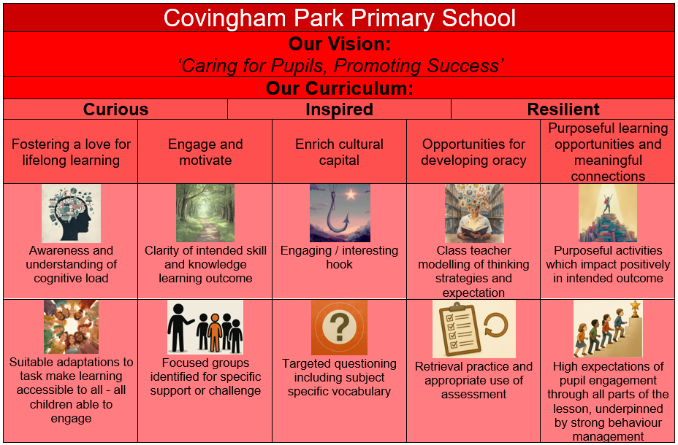

Slide 4
Long term overview

Slide 5
Curious. Inspired. Resilient Year 1 and 2 Curriculum Overview (Term 1)
Who’s in Charge?: Children explore monarchy and leadership by learning about King Charles III and comparing how monarchs are represented, remembered and understood today and within living memory. Significant Person: King Charles III (Inspired) Has consistently promoted environmental awareness and sustainability over many years. |  | ‘The Queen’s hat story. A guide to becoming king or queen. |  |  | The Queen’s Hat The Queen's Handbag The Queen's Knickers The King’s Pants The King’s Hats |  |  | Place Value within 20 Additon and Subtraction within 20
HISTORY |  |  | DT |  |  |  | SCIENCE
Main History Focus: Learning about monarchy and leadership through changes within living memory and the role of a significant contemporary monarch. |  |  | Main DT Focus: Mechanisms: designing, making and evaluating a moving picture using a simple slider mechanism. |  |  |  | Main Science Focus: Learning about plants by identifying common plants and trees, naming the basic parts of a plant, and understanding what plants need to grow and stay healthy, while continuing to notice seasonal changes in the world around them.
COMPUTING | PSHE |  |  | PE |  | RWV |  | OTHER
Online Safety: - Healthy and safe choices - Helping Alex - Where and how? Being positive | Jigsaw - Being me in my World (Y2) |  |  | Dance |  | Christianity |  | Phonics Handwriting Early Morning Tasks Fitness Friday

Slide 6
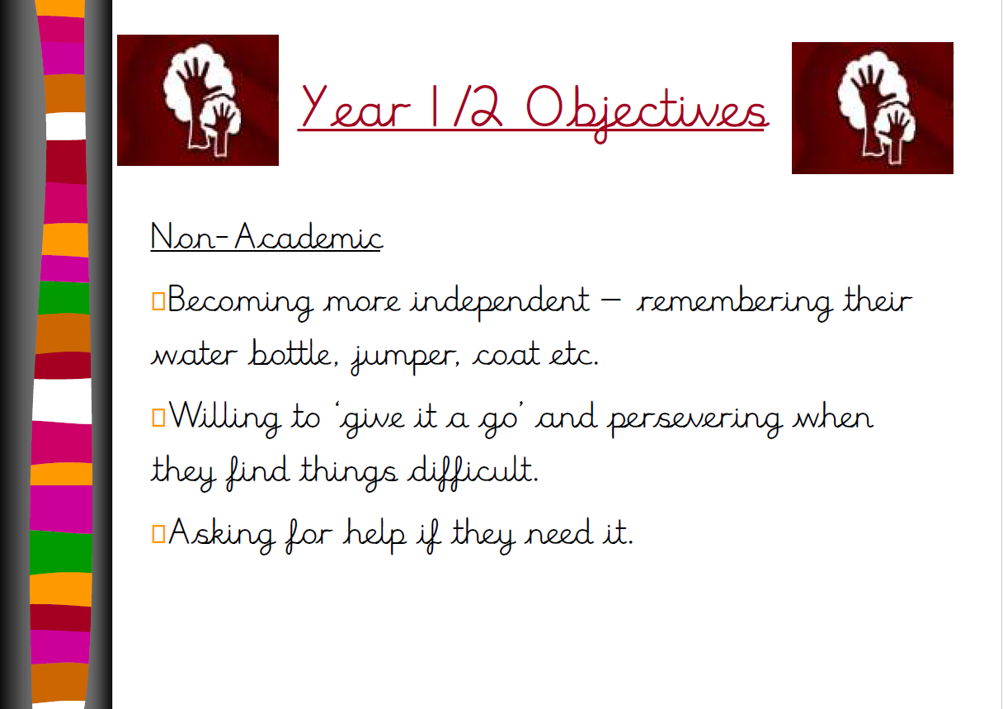

Slide 7
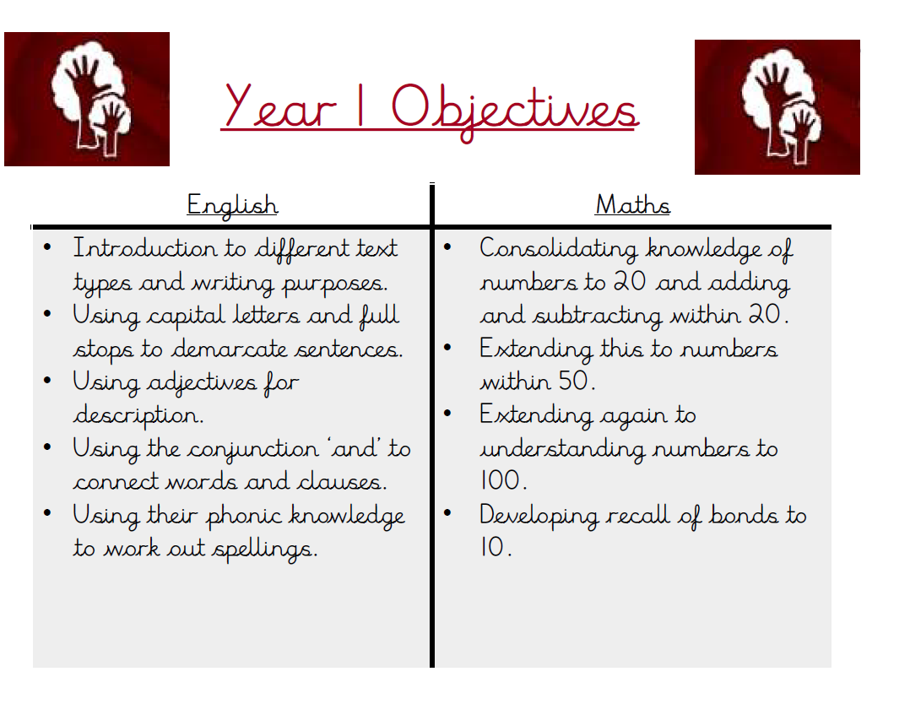

Slide 8
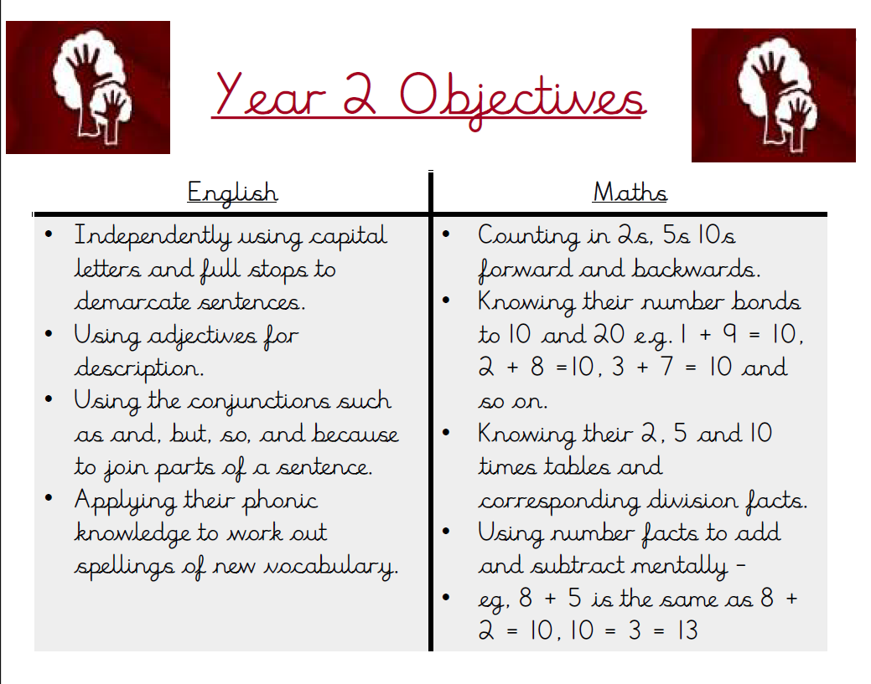

Slide 9
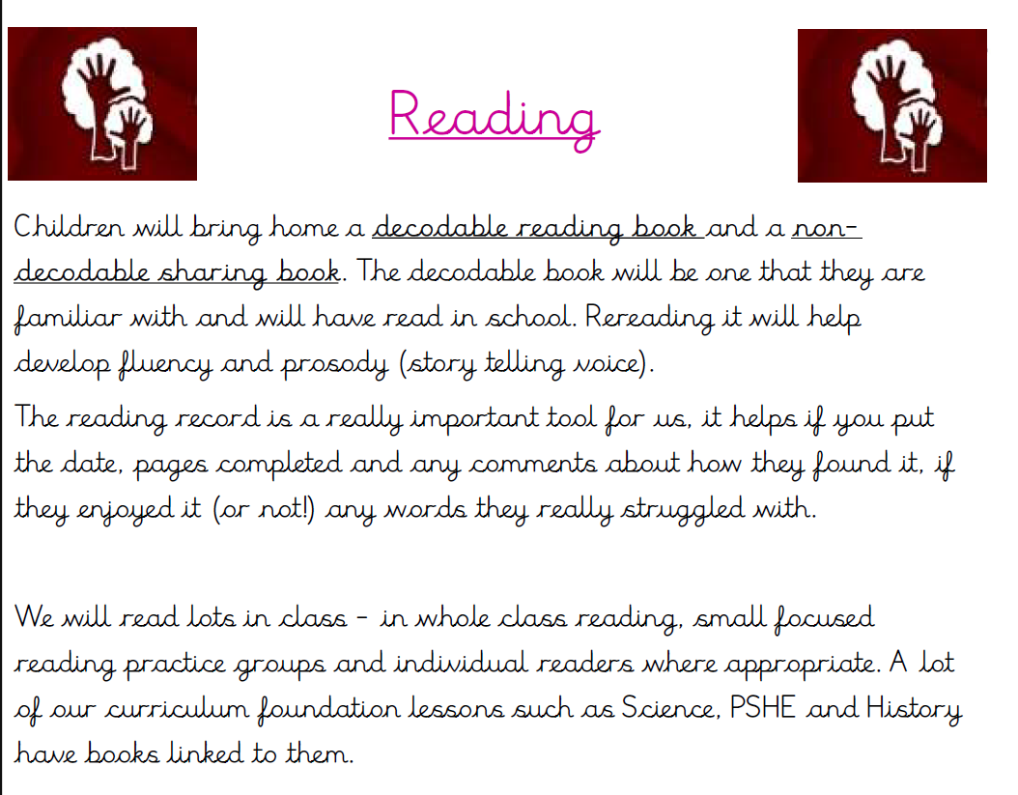

Slide 10
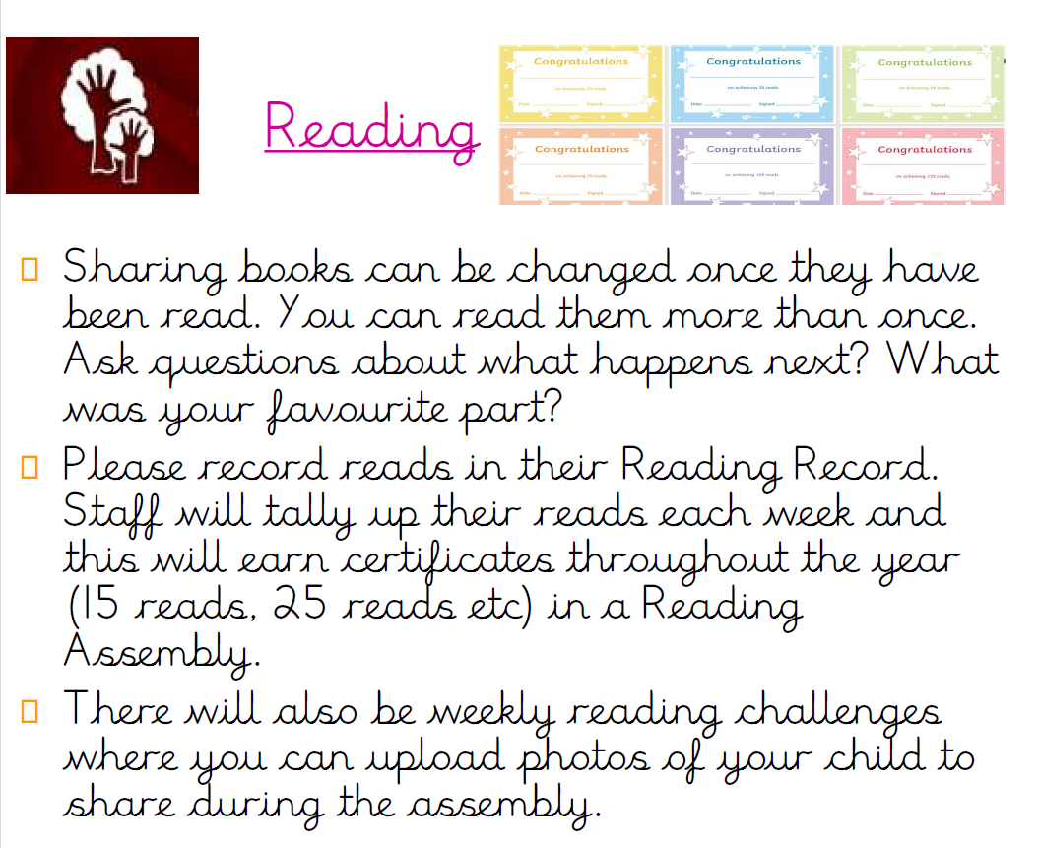

Slide 11
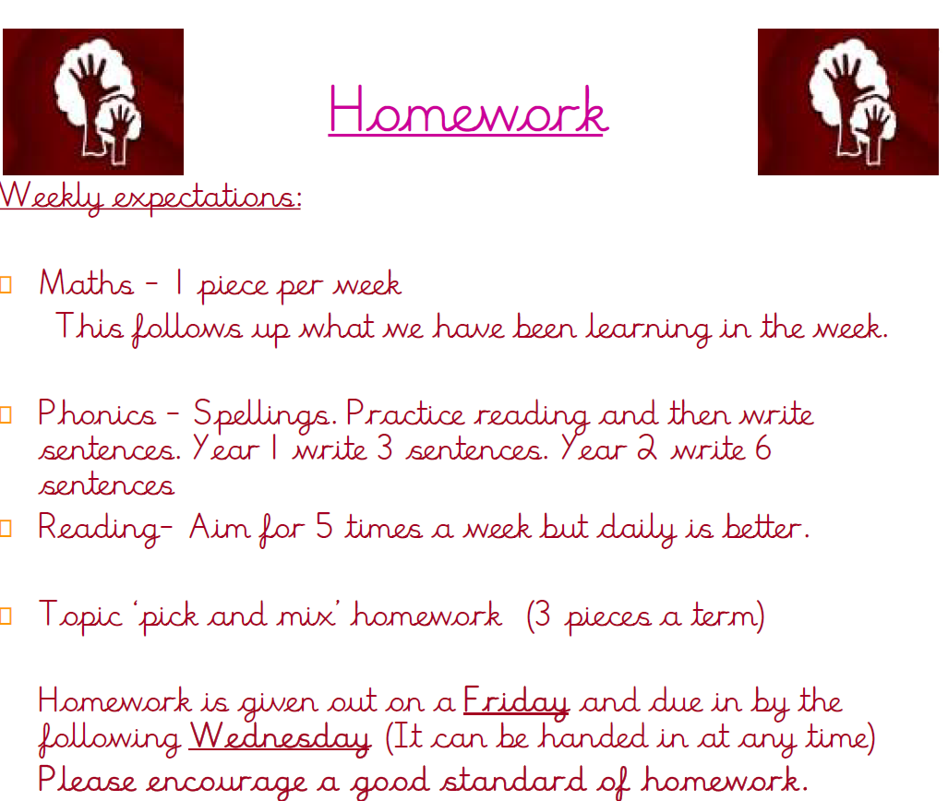

Slide 12
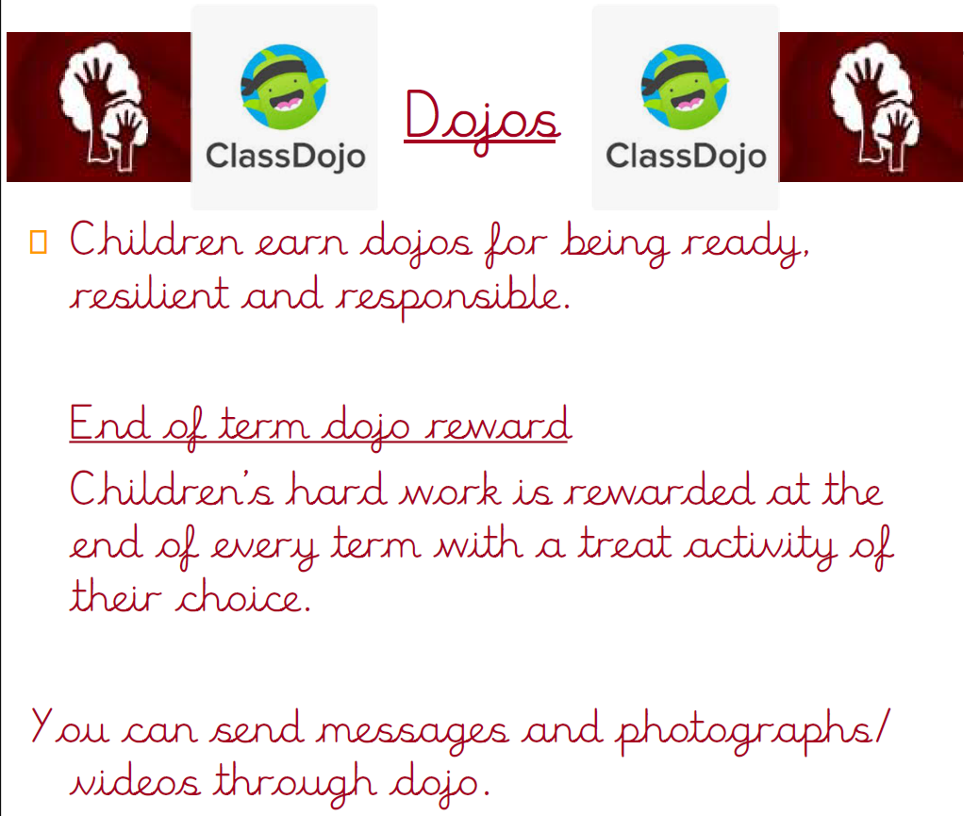

Slide 13
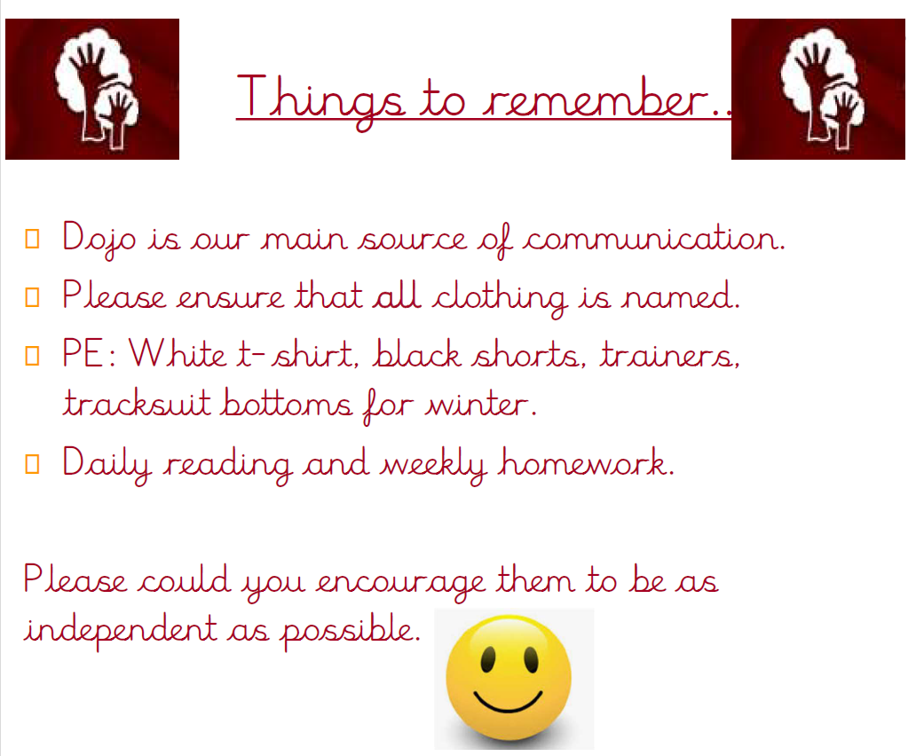

Slide 15


